Slide 1
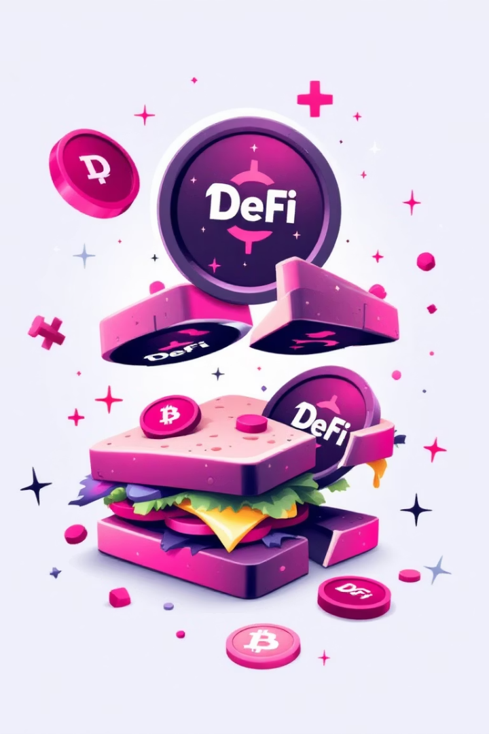
Sandwich Attacks in DeFi: A Deep Dive
This presentation explores security vulnerabilities in Decentralized Finance (DeFi). We will highlight the risks of sandwich attacks on users.
This is an educational presentation for understanding and preventing these attacks.
Notes:
My name is Çetin Boran Mesüm, and today I will be explaining what a sandwich attack is, why it is important, how it works, its implications, and how we can prevent it.

Slide 2
What is a Sandwich Attack?
Exploiting DEX Vulnerabilities
The Core Mechanics
Sandwich attacks exploit vulnerabilities in decentralized exchanges (DEXs).
These attacks involve front-running and back-running a target transaction.
They manipulate transaction order to profit at the user's expense.
For example, when a user buys tokens, the attacker inflates the price.
Notes:
he basic logic of a sandwich attack is as follows:
First, we perform front-running, buying before our target makes their transaction, which increases the price. Then, after our target completes their transaction, we perform back-running by selling at the elevated price. As a result, we profit from the difference between back-running and front-running.

Slide 3

Why Sandwich Attacks Matter
50B+
Daily Trading Volume
DEXs handle over $50 billion in daily trading volume.
The impact of sandwich attacks can be significant due to the high volumes of transactions. The price manipulations can erode user confidence in DeFi.

Slide 4




How Sandwich Attacks Impact Users
Increased Slippage
Reduced Transaction Value
Increased slippage leads to higher purchase prices.
Reduced value of transactions due to price manipulation.
Negative Impact on Trust
Negative impact on trust and adoption of DeFi platforms.
For example, a user might lose $500 on a $1000 trade due to a sandwich attack.

Slide 5





The Mechanics of a Sandwich Attack
Front-running
Attacker spots a pending transaction.
Target Transaction
The victim's trade to buy or sell tokens.
Back-running
Attacker sells after victim buys.
Profiting
Exploiter pockets the price difference.

Slide 6








Visualizing the Attack
Initiate Buy Order
Front-running
Victim initiates buy order.
Attacker's transaction inflates price.
Back-running
Higher Price
Attacker dumps tokens.
Victim executes at a higher price.
The attacker profits from the price difference.

Slide 7



Countermeasures and Prevention
Slippage Tolerance
Implement slippage tolerance settings.
Anti-Front-Running DEXs
Use DEXs with anti-front-running mechanisms.
Monitor Transactions
Monitor transaction execution and price impact.
Consider using DEXs like CowSwap and UniswapX, which provide protection against front-running.
Notes:
Slippage Tolerance Settings: This setting allows you to accept a certain percentage of price slippage during a transaction. If the price changes too much, the transaction is canceled.
DEXs with Anti-Front-Running Mechanisms: These mechanisms prevent attackers from manipulating transactions by buying or selling before the target user, ensuring fair transactions.
Monitor Transaction Execution and Price Impact: This helps track whether a transaction is successfully completed and monitors how much the price changes during the process, avoiding unexpected price fluctuations.

Slide 8

Conclusion: Staying Safe in DeFi
Understand Risks
Implement Measures
Understanding the risks of sandwich attacks.
Implementing preventive measures for protection.
Continuous Learning
Continuous learning and vigilance in the DeFi space.
Further education and security audits are valuable resources to stay protected.

